Slide 1
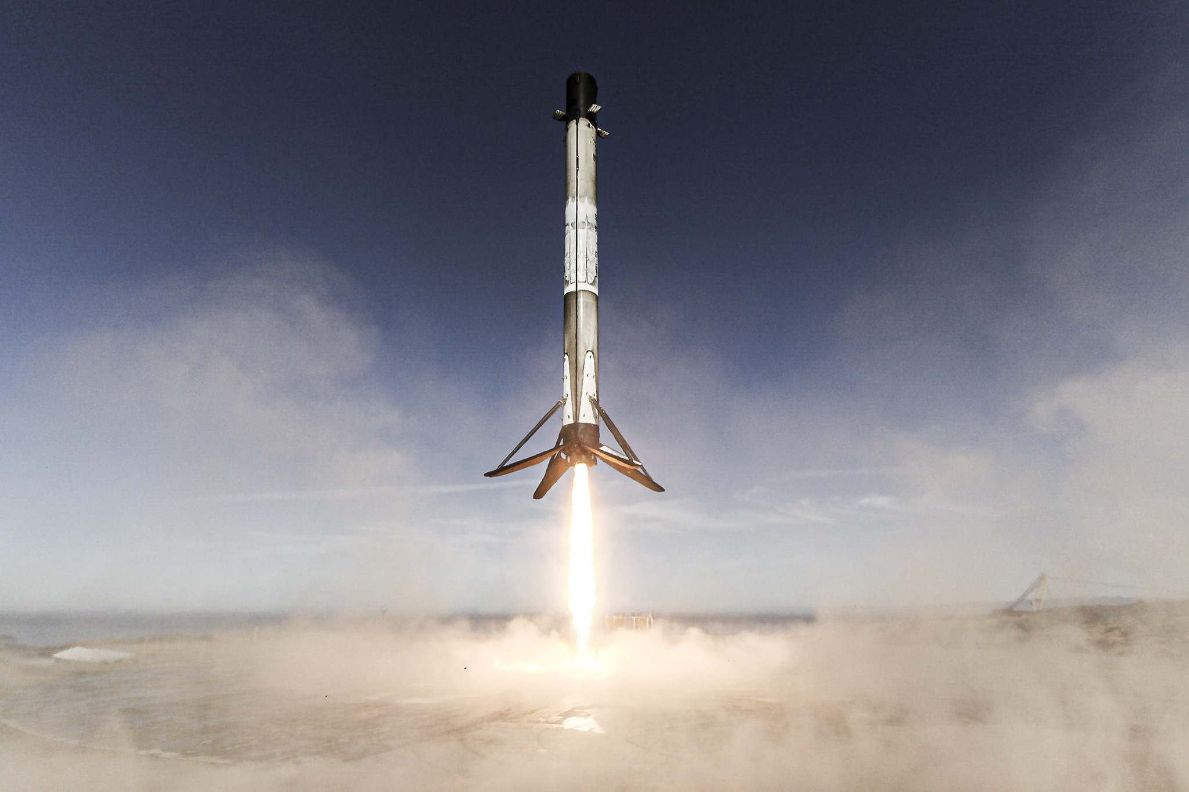








Rocketing Ahead: Leveraging Data Science in the New Space Age
Kyriakos Fotiou
Nov 2023

Slide 2


OUTLINE
Executive Summary
Introduction
Methodology
Results
Discussion
Conclusion
Appendix

Slide 3
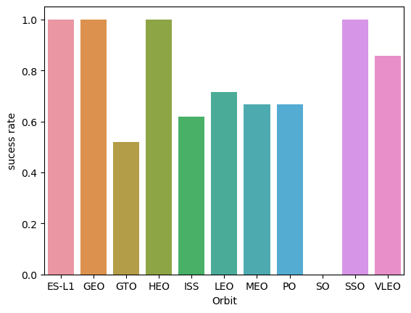
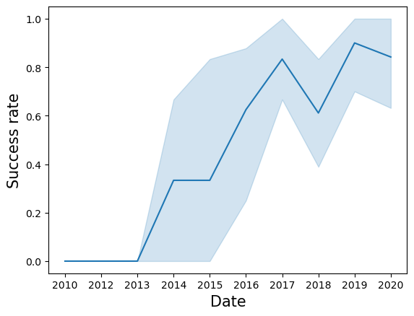
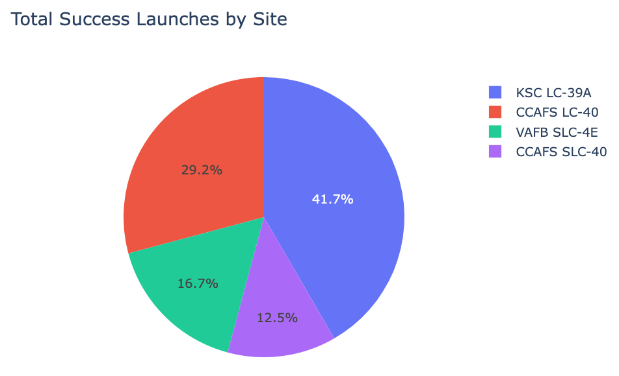
EXECUTIVE SUMMARY
Acquired SpaceX datasets through a data collection API and web scrapping.
Employed exploratory data analysis techniques to analyse and visualise the acquired data.
Utilising the Grid Search method to identify the most effective Machine Learning Model for predicting the classification of future landings.

Slide 4
INTRODUCTION
Given SpaceX's ability to reuse the first stage, the Falcon 9 rocket launches at a cost of 62 million dollars, significantly lower than the often-higher cost of up to 165 million dollars for rockets from other providers.
Therefore, by accurately predicting the successful landing of the first stage, we can estimate the cost of a launch. This predictive capability holds value for potential competitors bidding against SpaceX for rocket launches.
Key Questions:
Can historical launch data help predict the success of a new launch based on the first stage's landing outcome?
Is there a discernible choice that maximises the likelihood of a successful launch based on historical data analysis?

Slide 5
METHODOLOGY

Slide 6
METHODOLOGY
Data collection methodology:
SpaceX REST API
Web Scraping (Wikipedia)
Perform data wrangling:
Generate landing Class from Outcome column
Perform exploratory data analysis (EDA) using visualization and SQL.
Perform interactive visual analytics using Folium and Plotly Dash.
Perform predictive analysis using classification models.
Using GridSearchCV to find best fit model

Slide 7
Data Collection
REST API
Web Scraping
SpaceX REST API
Wikipedia Page
JSON
HTML
DataFrame
DataFrame

Slide 8
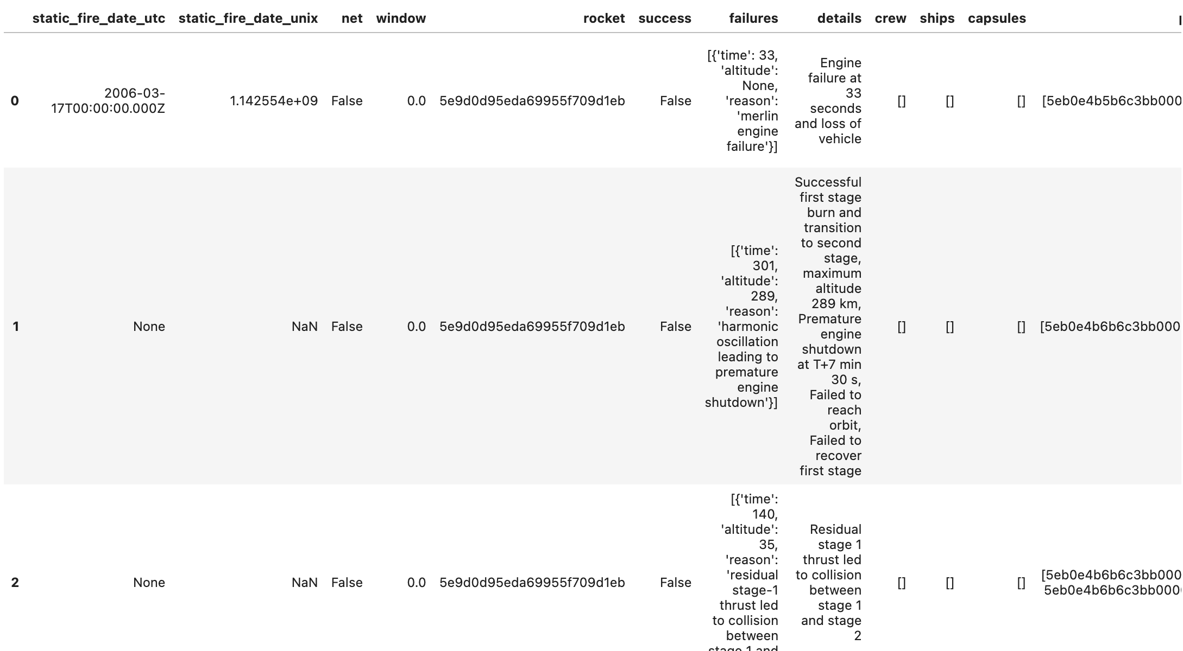
Data Collection – SpaceX API
SpaceX API repository https://github.com/r-spacex/SpaceX-API
Main Endpoint https://api.spacexdata.com/v4/launches/past
My Notebook
https://github.com/FotiouK/SpaceX_Data_Science/blob/main/1-jupyter-labs-spacex-data-collection-api.ipynb
import requests
import pandas as pd
spacex_url = "https://api.spacexdata.com/v4/launches/past" response = requests.get(spacex_url) data = pd.json_normalize(response.json())
SpaceX REST API
JSON
DataFrame

Slide 9
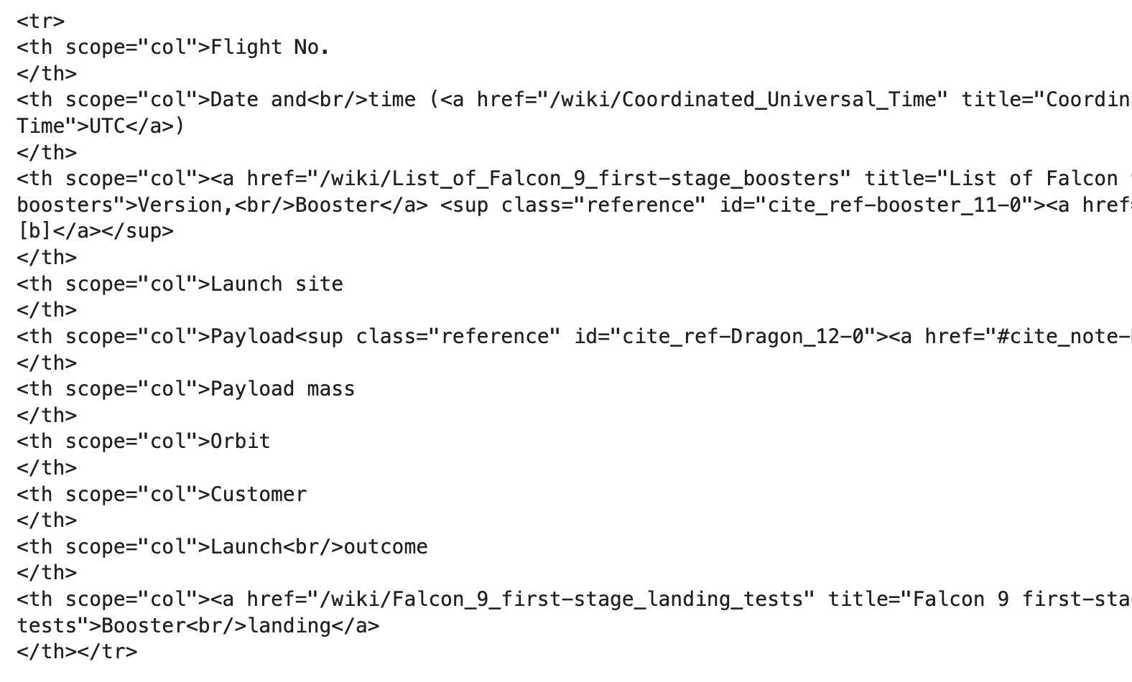
Data Collection – Web Scraping
Wikipedia Falcon Page https://en.wikipedia.org/wiki/List_of_Falcon_9_and_Falcon_Heavy_launches
My Notebook
https://github.com/FotiouK/SpaceX_Data_Science/blob/main/2-jupyter-labs-webscraping.ipynb
import requests
from bs4 import BeautifulSoup url = 'https://en.wikipedia.org/wiki/List_of_Falcon_9_and_Falcon_Heavy_launches'
response = requests.get(url)
html_data = response.text
soup = BeautifulSoup(html_data)
Wikipedia Page
HTML
DataFrame

Slide 10
Data Wrangling
My Notebook https://github.com/FotiouK/SpaceX_Data_Science/blob/main/3-jupyter-spacex-data-wrangling.ipynb
Refine the raw data by creating a new landing classification column based on the original outcome labels. This column will serve as our target for predicting landing success, denoted as:
1 for success
0 for failure
Original Outcome
Landing Class
True ASDS
None None
True RTLS
False ASDS
True Ocean
False Ocean
None ASDS
False RTLS
1
0
1
0
1
0
0
0

Slide 11
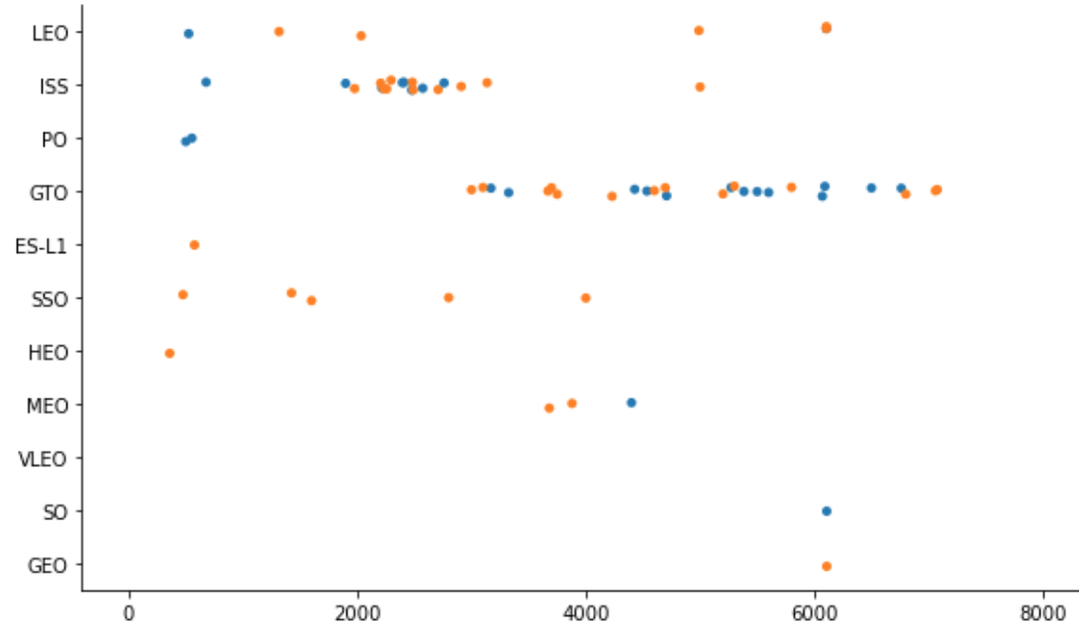
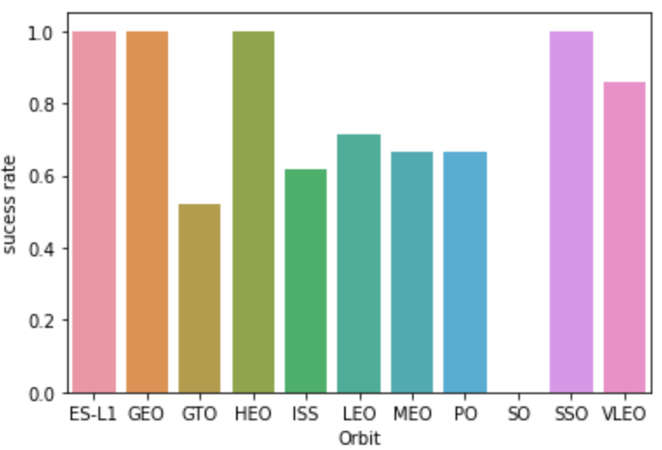
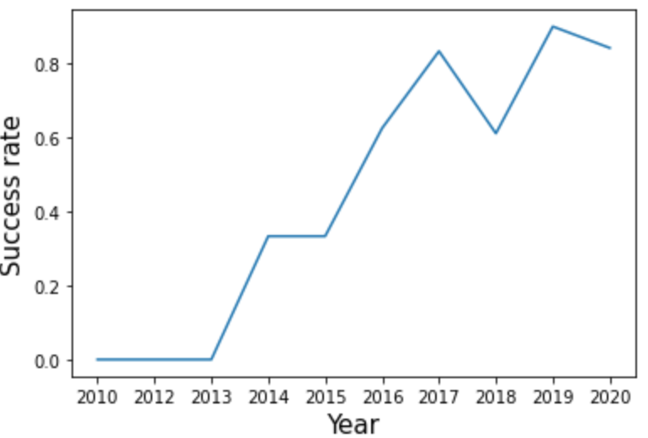
EDA with Data Visualisation
My Visualization Notebook https://github.com/FotiouK/SpaceX_Data_Science/blob/main/5-jupyter-labs-eda-dataviz.ipynb
Scatter Plot | Acquire relationship between variables, Flight Number vs. Orbit type Payload vs. Orbit type Flight Number vs. Payload Mass Flight Number vs. Launch Site
Bar Plot | Plot success rate of each orbit
Line Chart | Acquire yearly average launch success trend

Slide 12
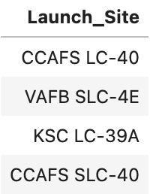
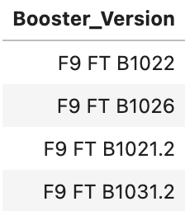
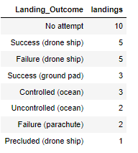
EDA with SQL
My SQL Notebook https://github.com/FotiouK/SpaceX_Data_Science/blob/main/4-jupyter-labs-eda-sql-coursera_sqllite.ipynb
%sql select distinct Launch_Site from SPACEXTBL
Query the names of the unique launch sites in the space mission
Query the names of the booster_versions which have carried the maximum payload mass.
List the total number of successful and failure mission outcomes
List the names of the boosters which have success in drone ship and have payload mass in some range
Rank the count of successful landing_outcomes in date range in descending order.

Slide 13
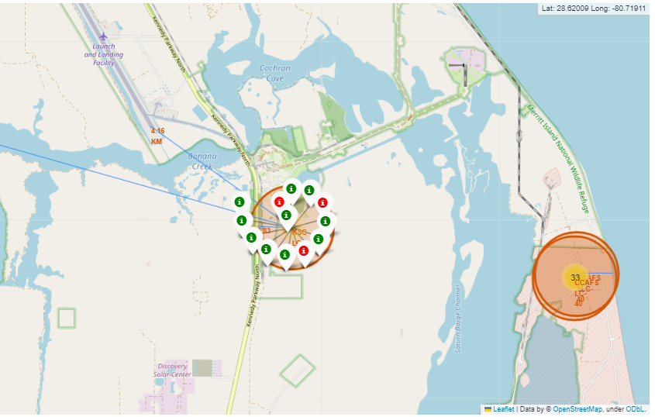
Interactive Map with Folium
Add Circles for Launch sites and Markers for labels
Add MarkerCluster for successful and failed launches
Add Lines for calculate distance between launch sites and their proximities
My SQL Notebook https://github.com/FotiouK/SpaceX_Data_Science/blob/main/6-jupyter_launch_site_location_folium.ipynb

Slide 14
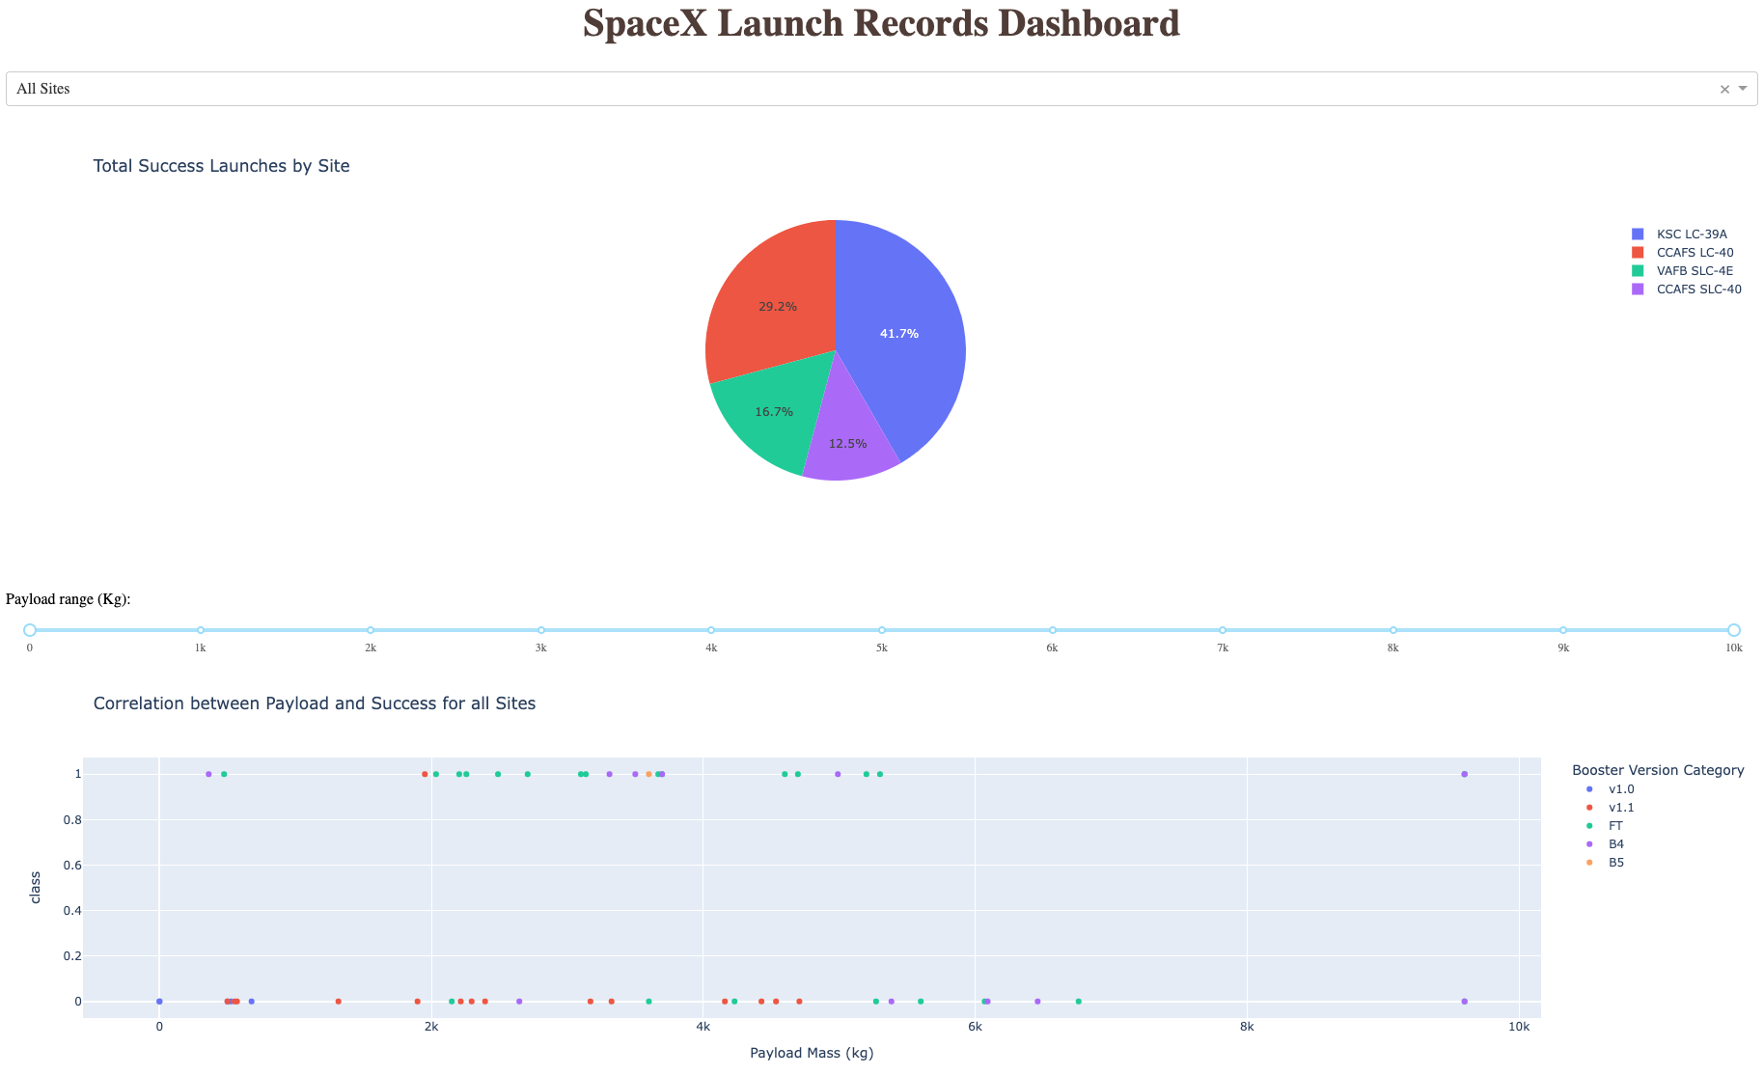
Build Dashboard with Plotly Dash
Dropdown menu + Pie Chart: Visualises success launch distribution per launch site.
Range Slider + Scatter Plot: Analyses Payload vs. Success correlation across diverse launch sites.
My SQL Notebook https://github.com/FotiouK/SpaceX_Data_Science/blob/main/7-spacex_dash_app.py.ipynb

Slide 15
Predictive Analysis(Classification)
Prepare data
Create a column for the class
Standardize the data
Split into training data and test data
Define model and parameters
Train and Grid Search for best parameters
Evaluation
Preprocess Data
Define Model
Train Model
Evaluate Model
Data Cleaning
Choose Model
Tune Model
Accuracy Analysis
Data Transformation
Model Parameters
Grid Search
Model Plot
Dataset Splitting
My Notebook
https://github.com/FotiouK/SpaceX_Data_Science/blob/main/8-SpaceX_Machine_Learning_Prediction.ipynb

Slide 16
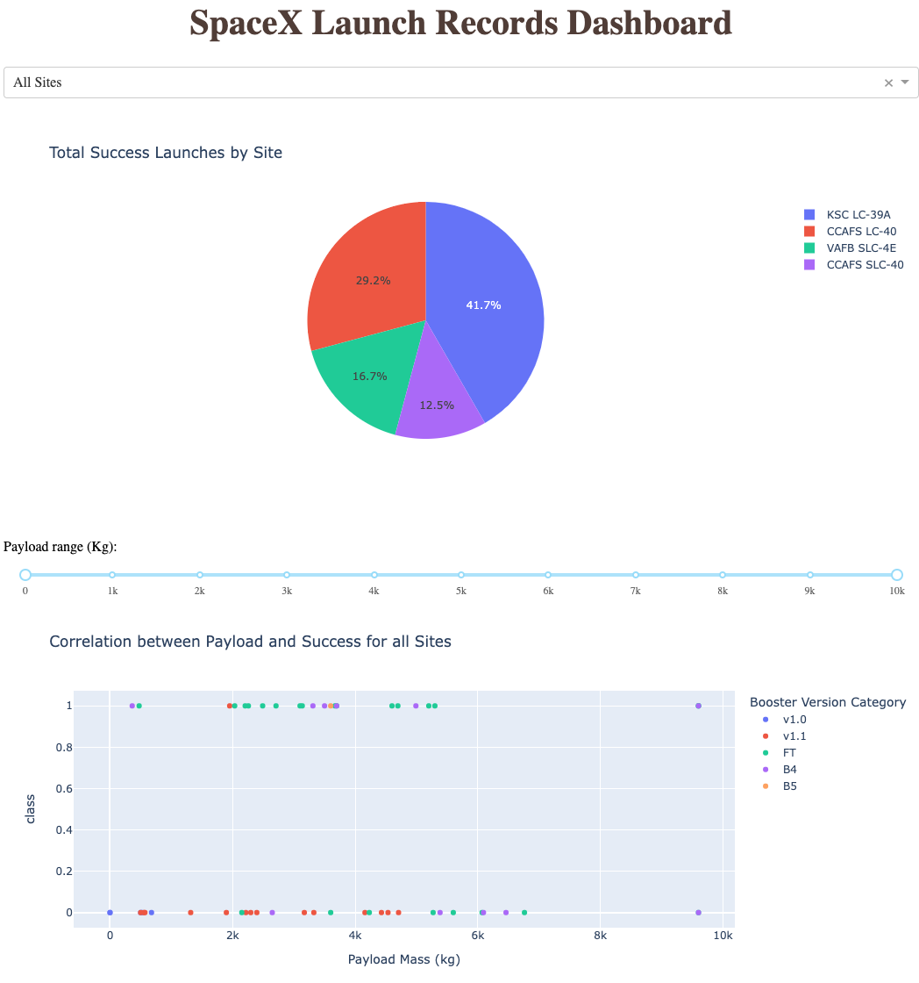
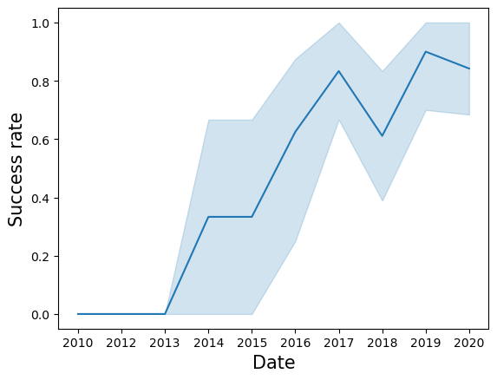
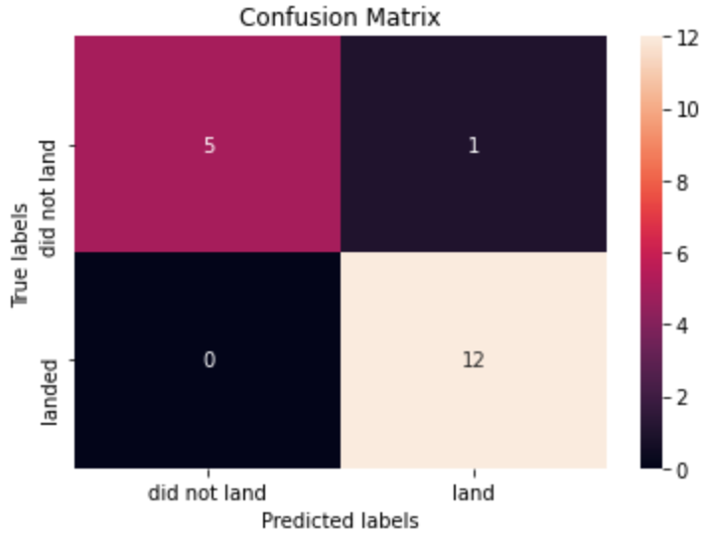
RESULTS

Slide 17
Insight Drawn from EDA

Slide 18
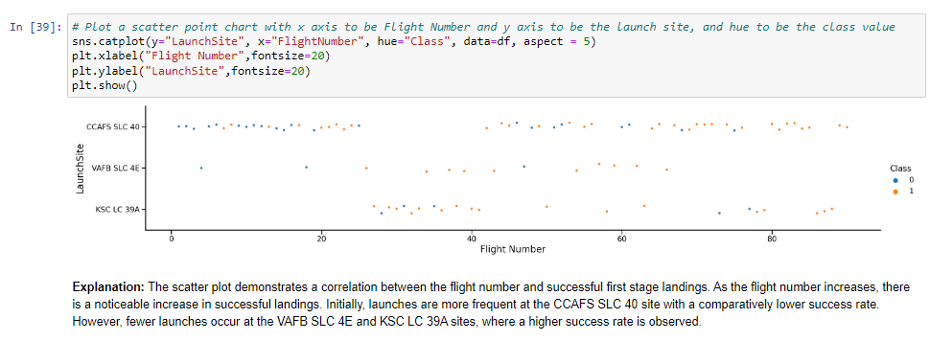
Flight Number VS Launch Site

Slide 19
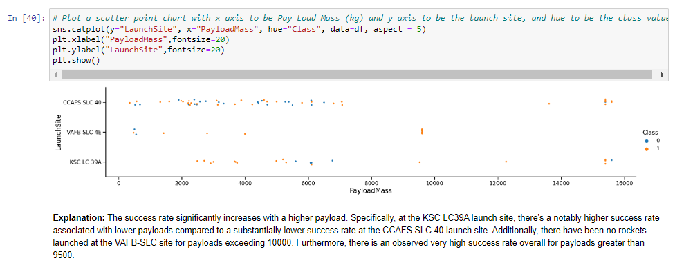
Payload VS Launch Site

Slide 20
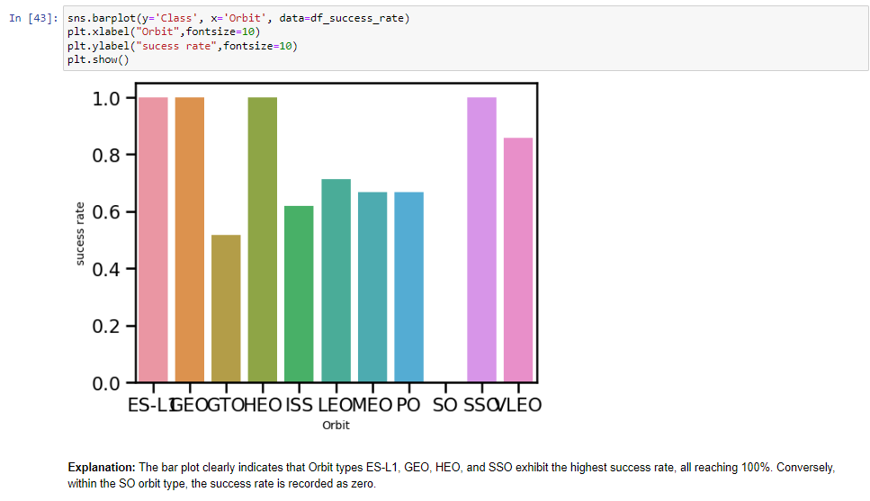
Success Rate VS Orbit Type

Slide 21
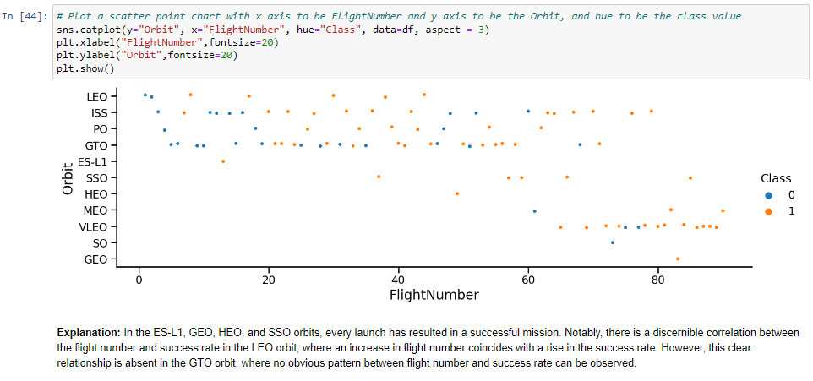
Flight Number VS Orbit Type

Slide 22
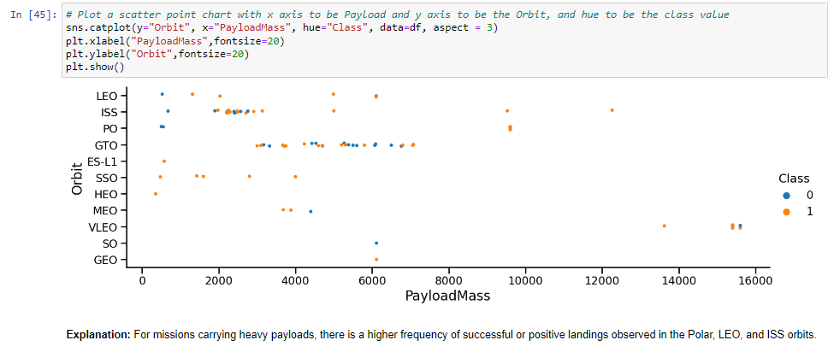
Payload VS Orbit Type

Slide 23
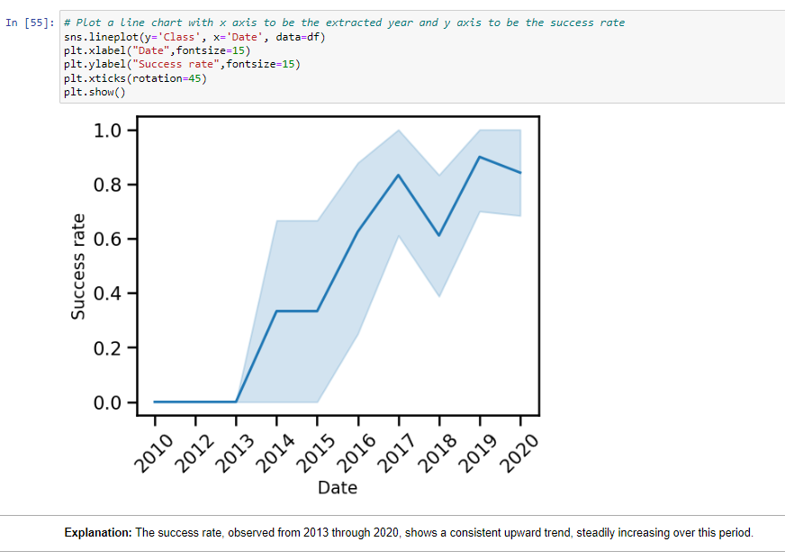
Launch Success Yearly Trend

Slide 24
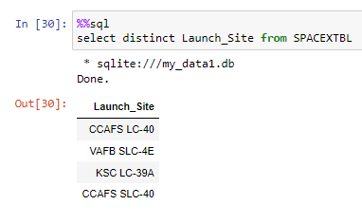
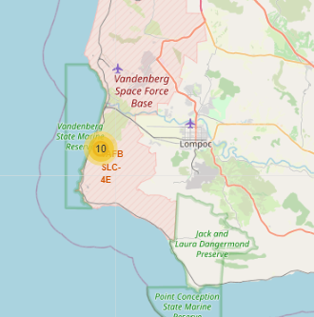
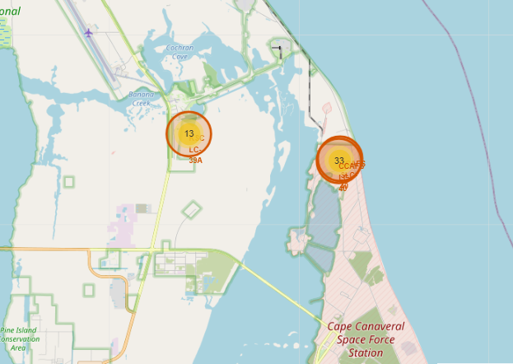
All Launch Site Names
Four Launch Sites:
CCAFS LC-40
VAFB SLC-4E
KSC LC-39A
CCAFS SLC-40
1 in western coast
VAFB SLC-4E
3 in eastern coast
KSC LC-39A
CCAFS SLC-40
CCAFS LC-40

Slide 25
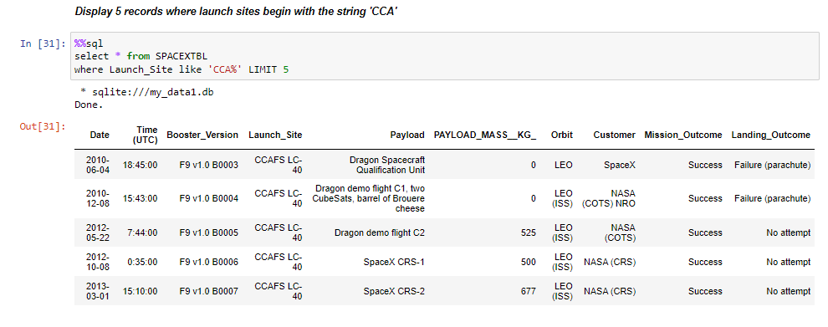
Launch Sites Names Begin with CAA

Slide 26
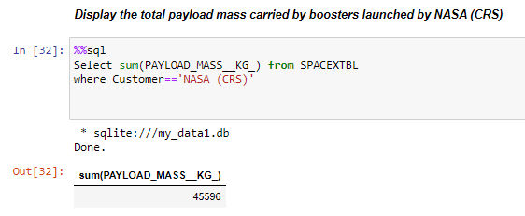
Total Payload Mass

Slide 27
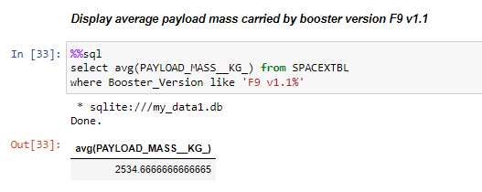
Average Payload Mass carried by F9V1.1

Slide 28
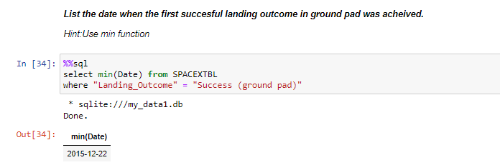
First Saucerful Ground Pad Landing

Slide 29
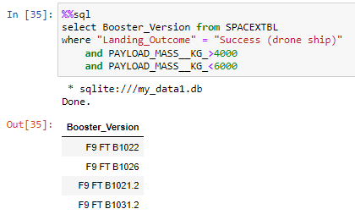
Successful Drone Ship Landing with Payload between 4000 and 6000
Explanation: names of boosters which have successfully landed on drone ship and had payload mass greater than 4000 but less than 6000
F9 FT B1022
F9 FT B1026
F9 FT B1021.2
F9 FT B1031.2

Slide 30
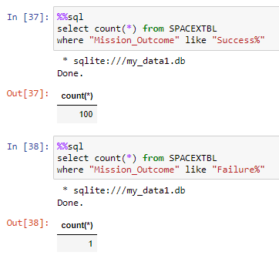
Total Number of Successful and Failure Mission Outcomes
Explanation:
the total number of successful mission outcomes is 100
the total number of failure mission outcomes is 1

Slide 31
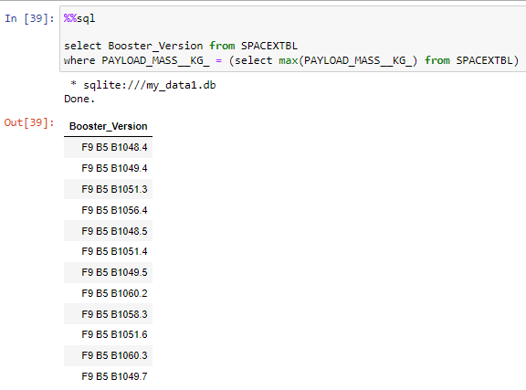
Boosters That Carried Maximum Payload
Names of the booster which have carried the maximum payload mass:
F9 B5 B1048.4
F9 B5 B1049.4
F9 B5 B1051.3
F9 B5 B1056.4
F9 B5 B1048.5
F9 B5 B1051.4
F9 B5 B1049.5
F9 B5 B1060.2
F9 B5 B1058.3
F9 B5 B1051.6
F9 B5 B1060.3
F9 B5 B1049.7

Slide 32
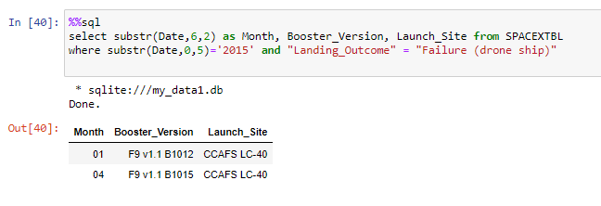
2015 Launch Records
Failed landing outcomes in drone ship, their booster versions, and launch site names for in year 2015:
Month | Booster_Version | Launch_Site
01 | F9 v1.1 B1012 | CCAFS LC-40
04 | F9 v1.1 B1015 | CCAFS LC-40

Slide 33
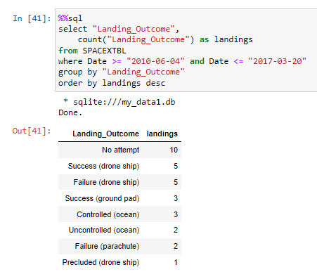
Rank Landing Outcomes Between 2010-06-04 and 2017-03-20
Rank the count of landing outcomes between the date 2010-06-04 and 2017-03-20:
Landing _Outcome | landings
Success | 20
No attempt | 10
Success (drone ship) | 8
Success (ground pad) | 6
Failure (drone ship) | 4
Controlled (ocean) | 3
Failure | 3
Failure (parachute) | 2
No attempt | 1

Slide 34
Launch Sites Proximity Analysis

Slide 35
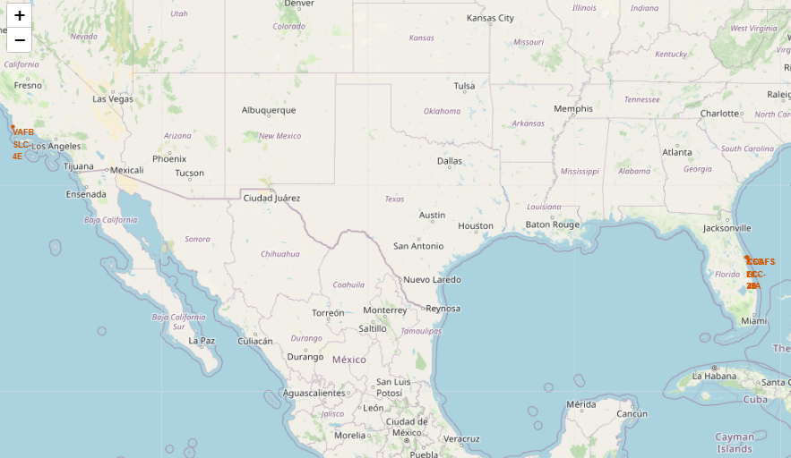
Locations of Launch Sites on Maps
Three in the east
One in the west
All in the south
Launch Site | Lat | Long
CCAFS LC-40 | 28.56230197 | -80.57735648
CCAFS SLC-40 | 28.56319718 | -80.57682003
KSC LC-39A | 28.57325457 | -80.64689529
VAFB SLC-4E | 34.63283416 | -120.6107455

Slide 36
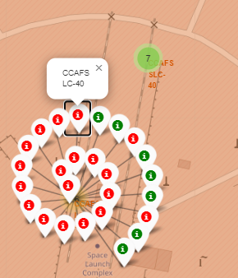
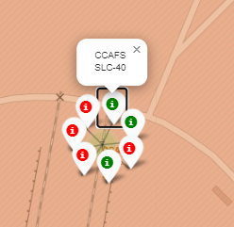
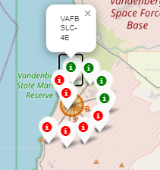
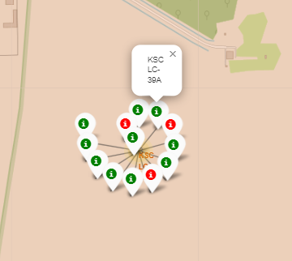
Display Launch Outcome by Color
From the color labels, we can easily see
KSC LC-39A has a rather higher success rate
Whereas CCAFS LC-40 and CCAFS SLC-40 have much lower rate

Slide 37
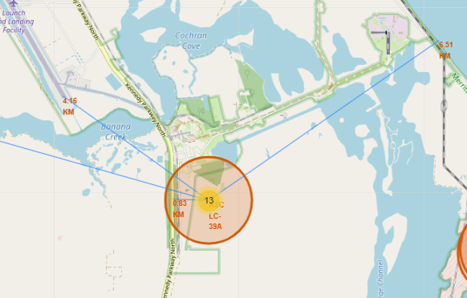
Display Launch Outcome by Color
The distance from KSC LC-39A to the nearest shuttle landing facility is about 4.16 km.
The distance from KSC LC-39A to the nearest highway is less than 1 km.
The distance from KSC LC-39A to the coastline is around 6.5 km.
The distance from KSC LC-39A to the nearest city is around 16 km.

Slide 38
Build Dashboard with Plotly Dash

Slide 39
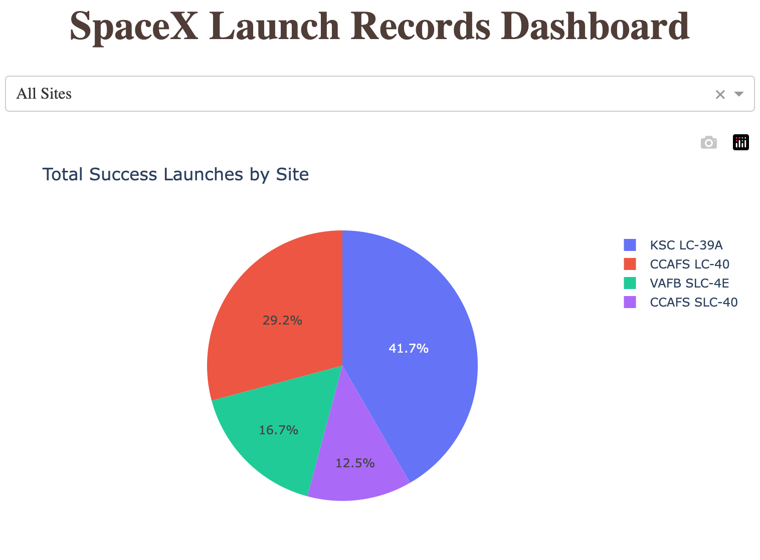
Total Success Launches for All Sites
Total Success Launches for All Sites is
CCAFS LC-40: 29.2%
VAFB SLC-4E: 16.7%
KSC LC-39A: 41.7%
CCAFS SLC-40: 12.5%

Slide 40
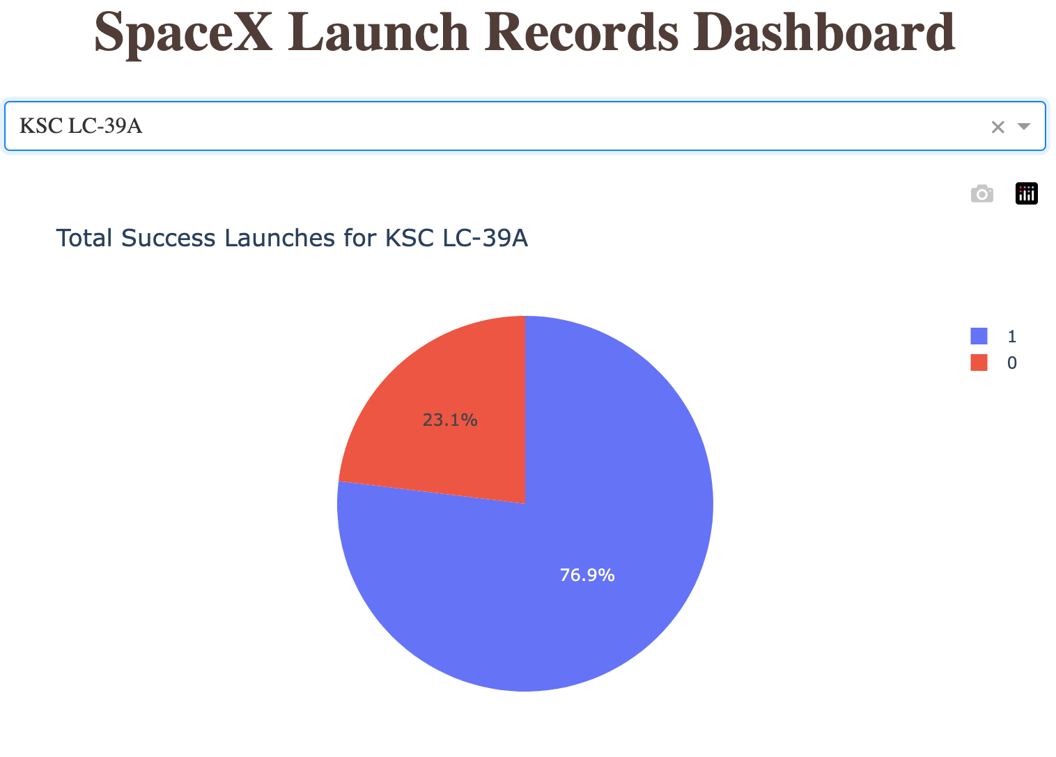
Success Ratio for KSC LC-39A
The launch site with highest launch success ratio is KSC LC-39A.
It has a success rate of 76.9%.

Slide 41
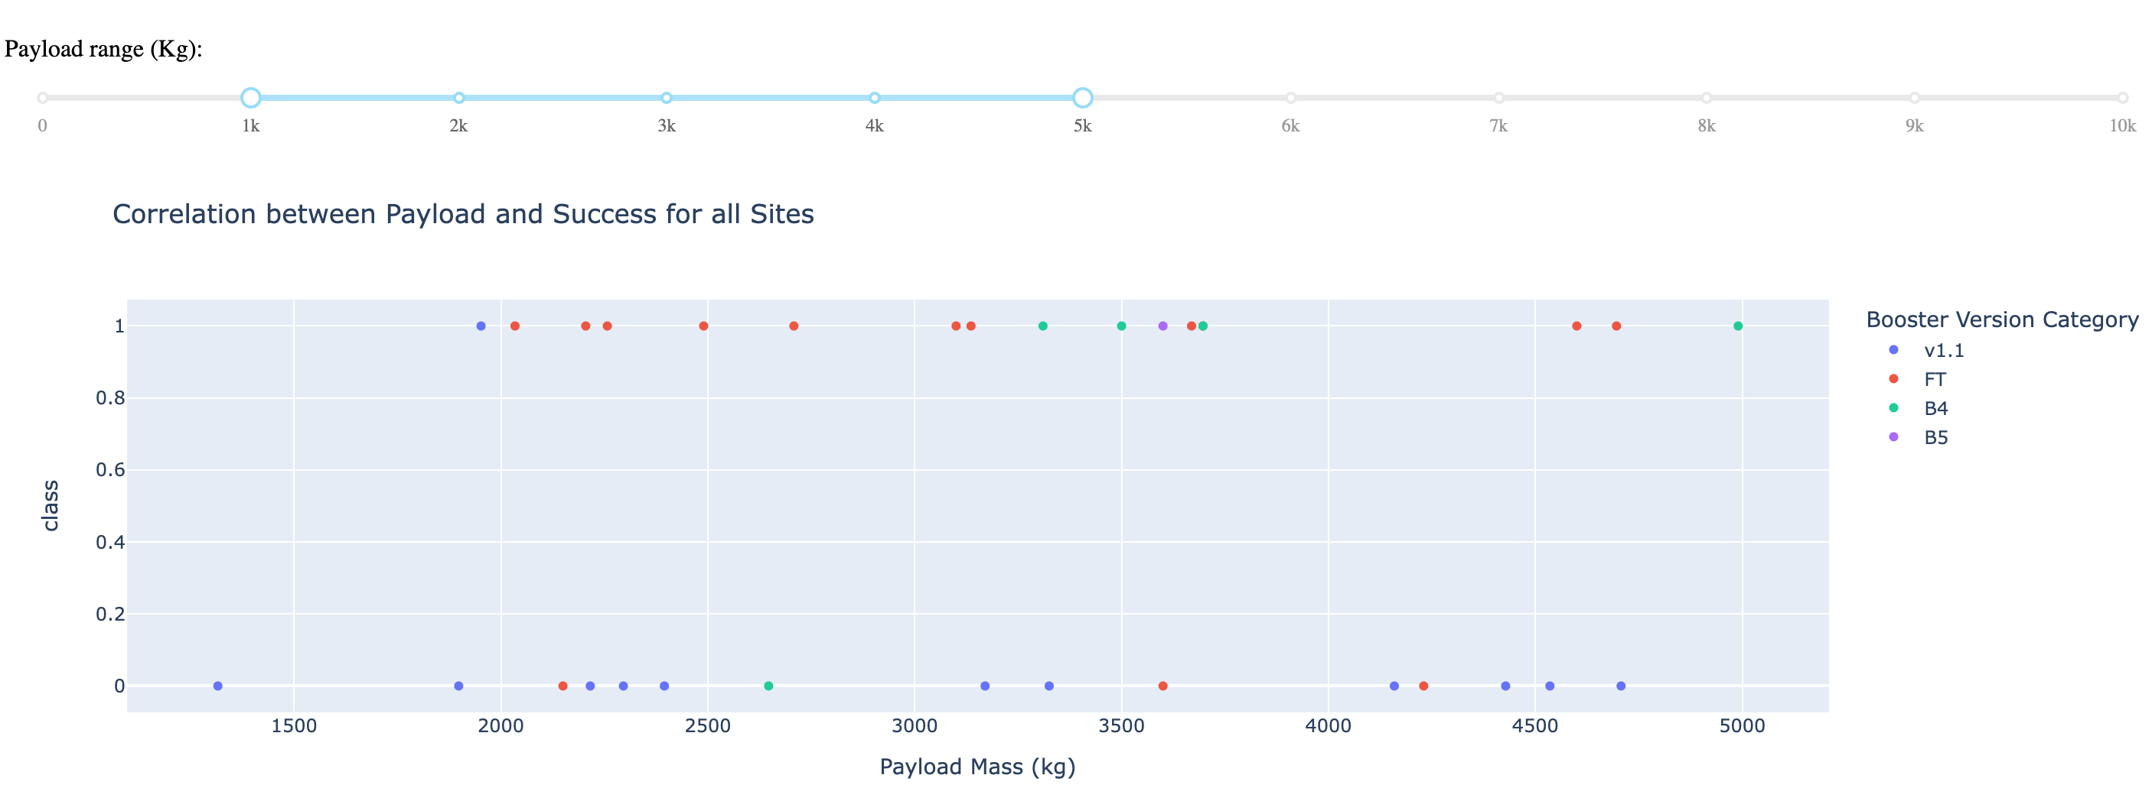
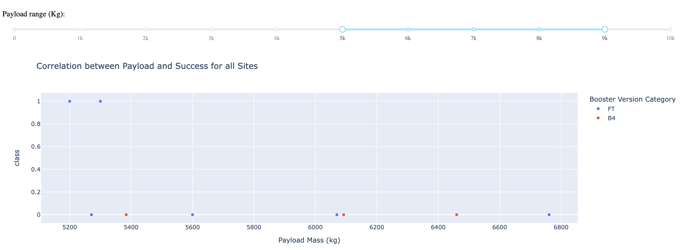
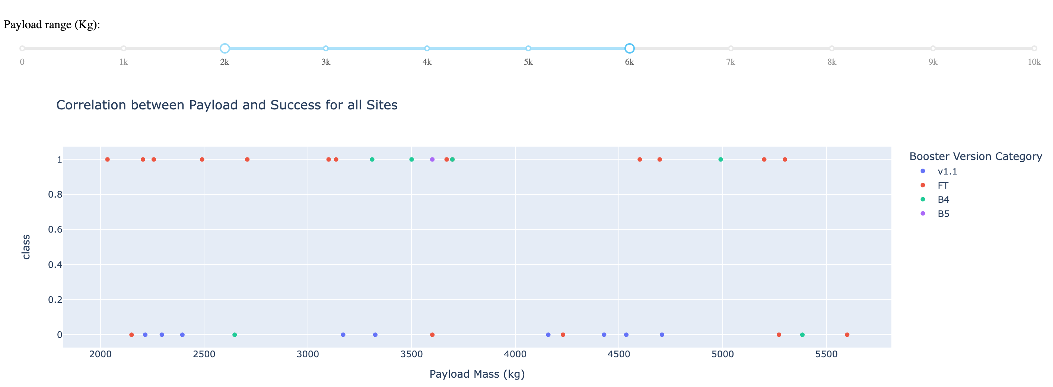
Correlation Between Payload and Success
Payload range in [3000, 4000] has the largest success rate.
Booster version of FT has the largest success rate.

Slide 42
Predictive Analysis Classification

Slide 43
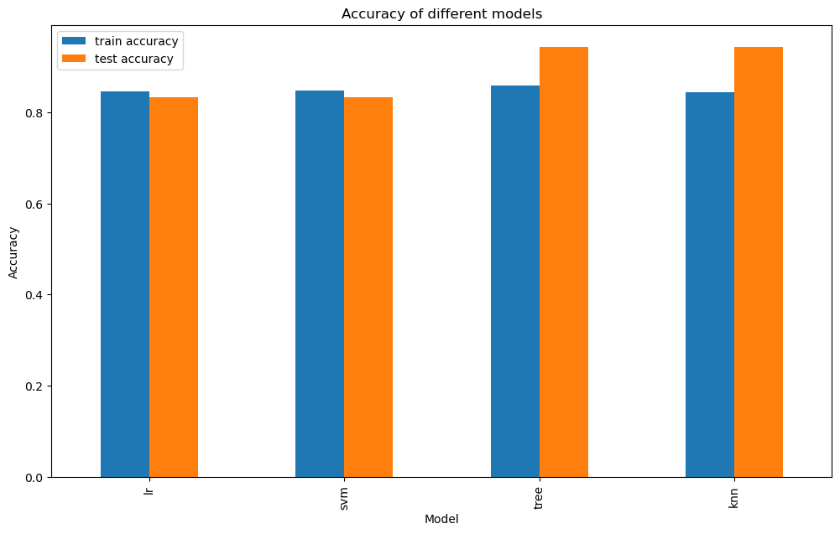
Classification Accuracy
Decision Tree model has the highest classification accuracy
training accuracy 0.86 and testing accuracy 0. 0.94
Parameter: {'criterion': ‘entropy', 'max_depth’: 10, 'max_features': ‘sqrt', 'min_samples_leaf’: 4, 'min_samples_split’: 5, 'splitter': 'random'}

Slide 44
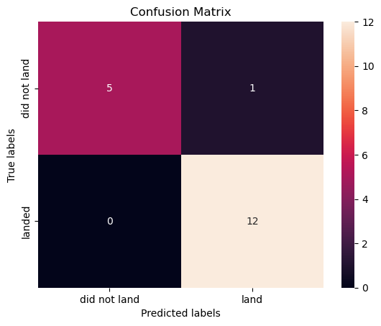
Confusion Matrix
Decision Tree model can distinguish between the different classes.
The major problem is False Positives.

Slide 45
Conclusions
The dataset comprises 90 rows and 83 columns. Through an 80/20 split, we allocated 72 rows for training and 18 for testing purposes.
Employing GridSearchCV, we trained four models, all exhibiting optimal performance on the test dataset.
From these models, our top choice for predicting rocket landing outcomes is the Decision Tree model.
However, utilising the decision tree may introduce concerns regarding false positives, potentially impacting our accuracy in estimating future bids for rocket launches.

Slide 46
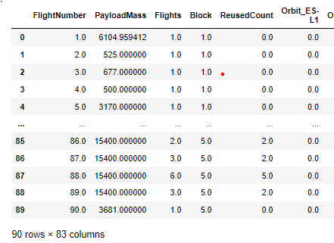
Challenges in Model Training
The dataset comprises 90 rows but contains 83 columns.
With an 80/20 split, our training set consists of only 72 records for training.
The imbalance of more features than samples raises concerns about overfitting during model training.
Additionally, we only have 18 test samples. Too few to find out problems.

Slide 47
Challenges in Model Training
How to handle this issue?
Obtain additional data, apply regularization, or employ dimension reduction techniques.
Consider removing irrelevant columns based on identified correlations during EDA.
Experiment with PCA to reduce dimensions efficiently.

Slide 48
Appendix
Share Links:
This Assignment GitHub Repository
IBM Data Science Professional Certificate
Other Reference Links:
Test accuracy higher than training. How to interpret?
More features than observations

Slide 49
Thank you!

